Slide 1
Ballistic basics

Slide 2
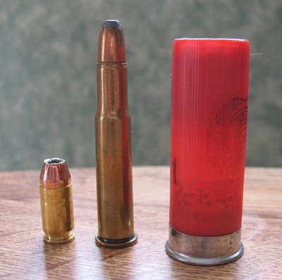
Three types of ammunition
Handgun, rifle, shotgun (left to right)

Slide 3
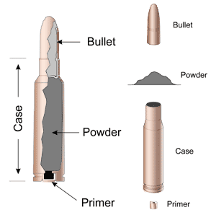
Cross section of cartridge

Slide 4
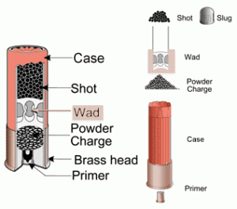
Cross section of shotgun shell

Slide 5
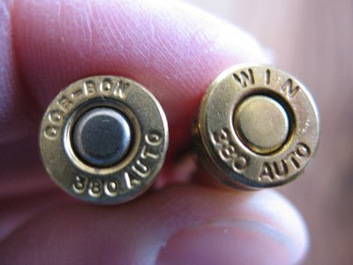
ammunition
USUALLY it is stamped on the base of the cartridge. This picture is of two different makers' .380 Auto round. They have the name of the manufacturer and the caliber stamped on them

Slide 6
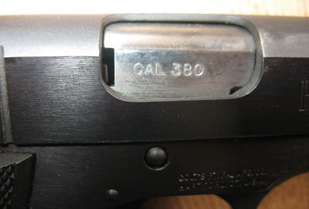
caliber
Your firearm should also have the caliber stamped somewhere on or near the barrel like this:

Slide 7
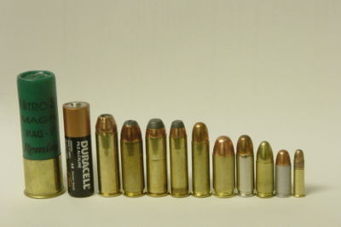
sizes

Slide 8
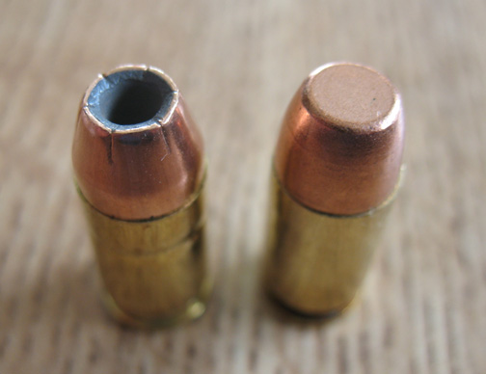
hollow

Slide 9
Why?
Hollowpoint rounds are made to expand when they hit the target so they cause more damage and do not shoot through the target as often. These are the rounds you want for self protection and hunting.

